Slide 1
d
Canal Magisterio
November 8, 2008

Slide 2
Arial Engineering
Charles Hoppesch - Andrea Smeltzer - Matthew Tronnes - Pamela Wolting
ceejuly-l@mtu.edu

Slide 3
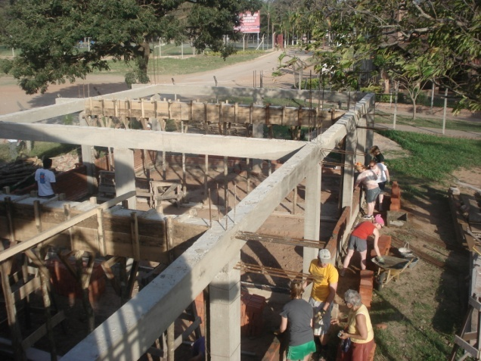
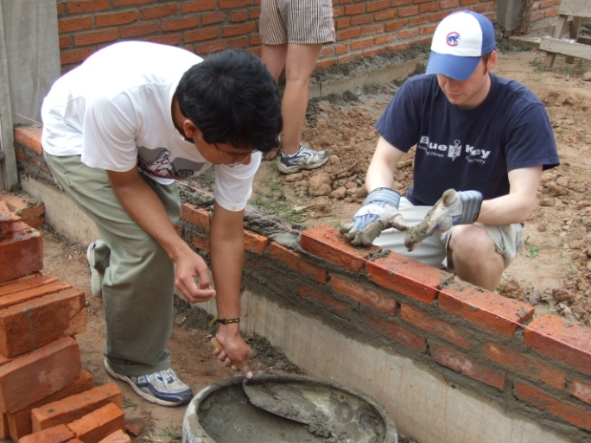
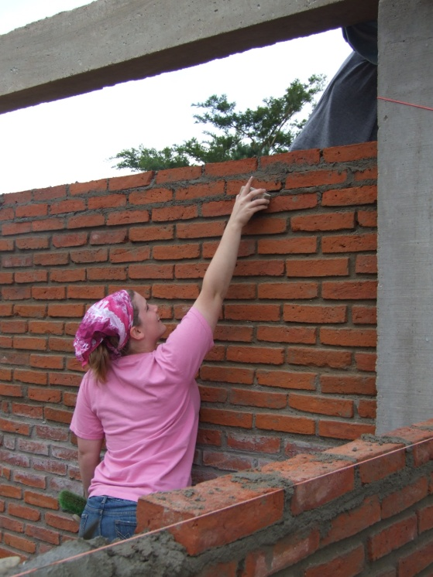
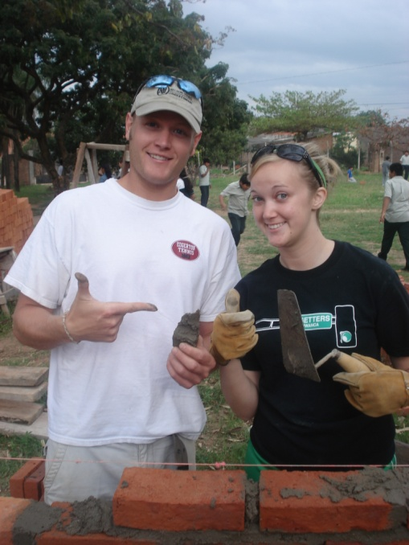
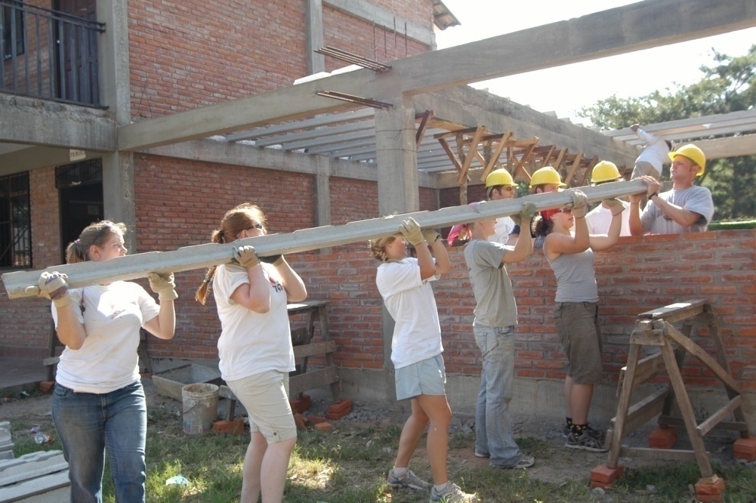
Construction

Slide 4
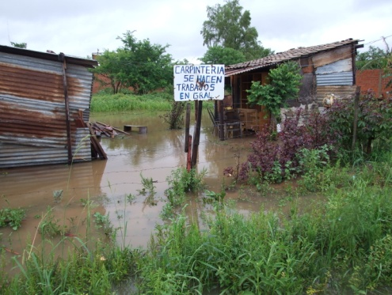
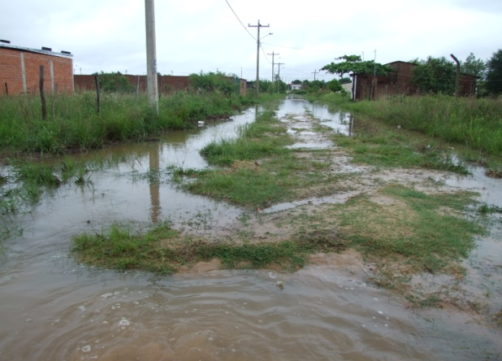
Canal Magisterio

Slide 5
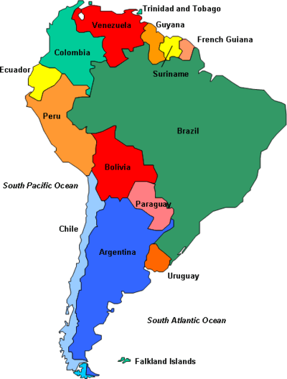
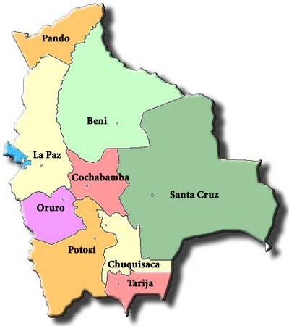
Bolivia

Slide 6
Districts

Slide 7
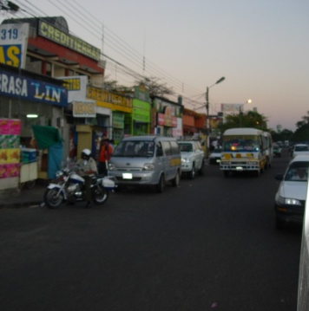
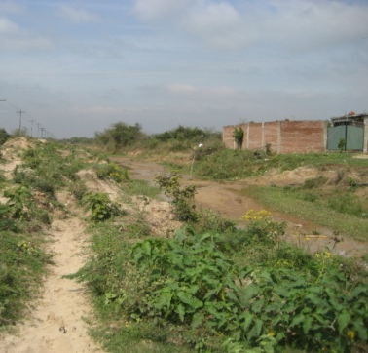
Environment in Santa Cruz
Urban
(Center of City)
Rural
(District 12)

Slide 8
Funding
$
$
$ $
$ $
$ $
$ $
$
¢ ¢
$ $
¢ ¢
¢ ¢
$ $
$ $
$ $
$ $
$ $

Slide 9
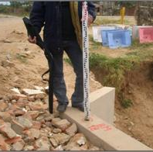
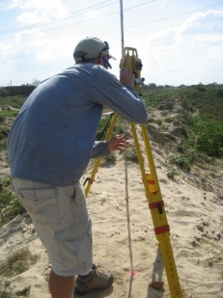
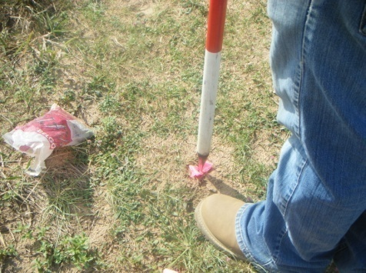
Surveying the Canal Site

Slide 10
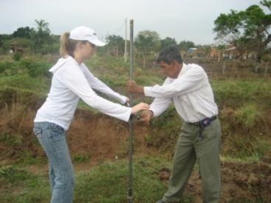
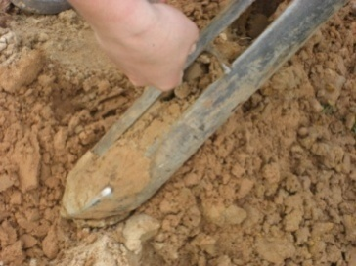
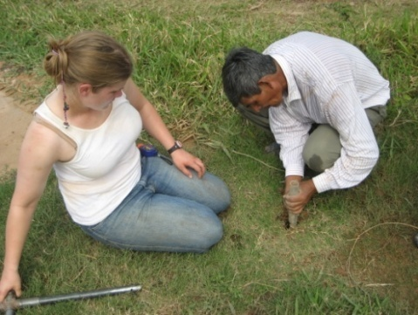
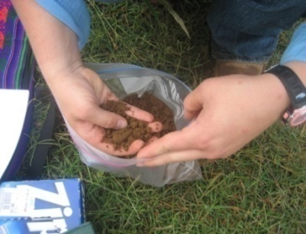
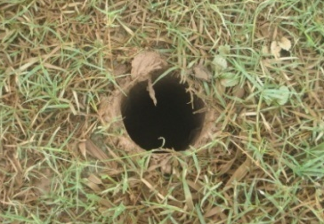
Soil Sampling in Canal Magisterio
Hand Auger
Classify Sample
Dig

Slide 11
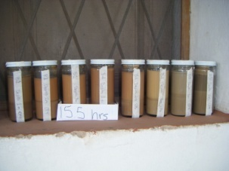
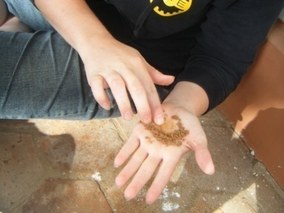
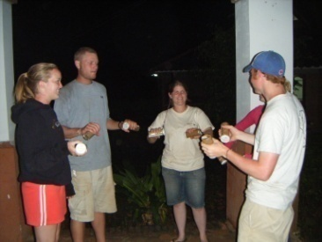
Soil Testing in Bolivia

Slide 12
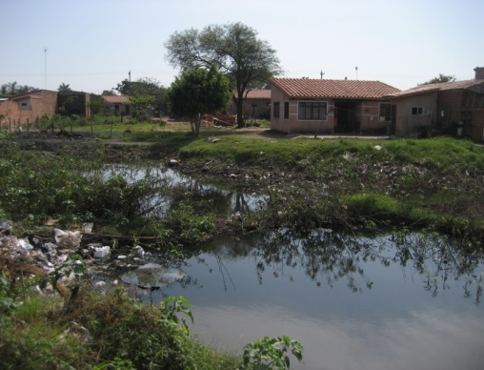
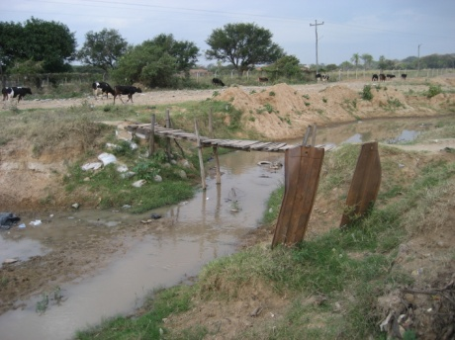
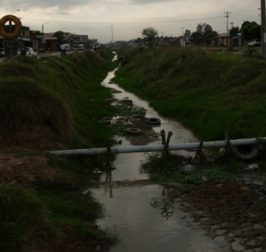
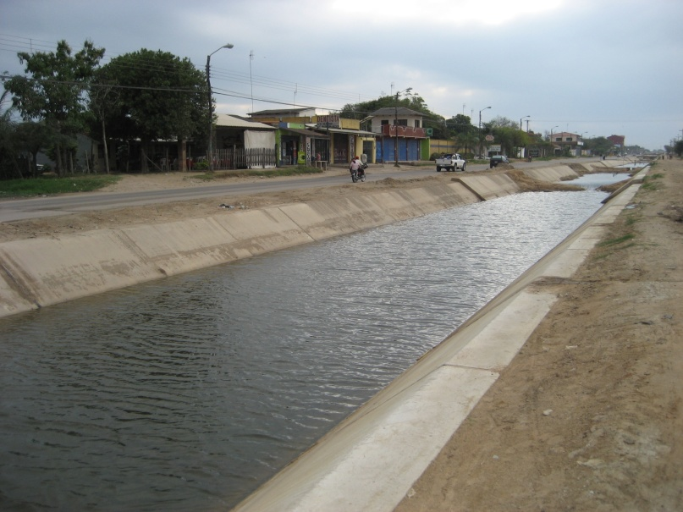
Existing Conditions

Slide 13
Canal Magisterio Currently
Railroad
Concrete Road
Earth Trench
Proposed Canal
El Terrible

Slide 14
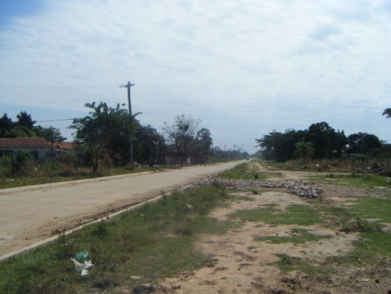
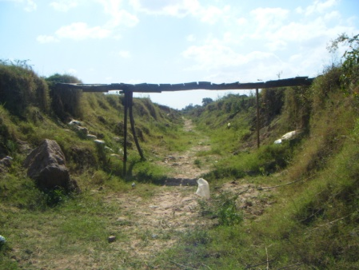
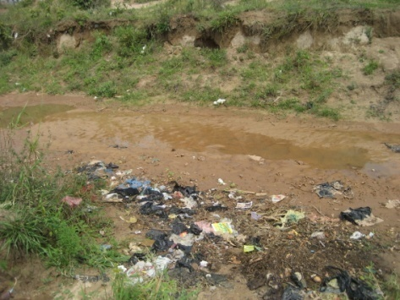
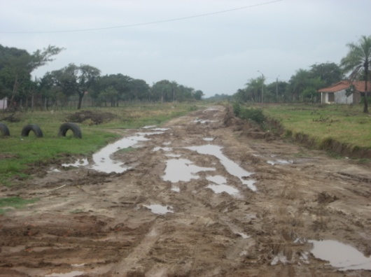
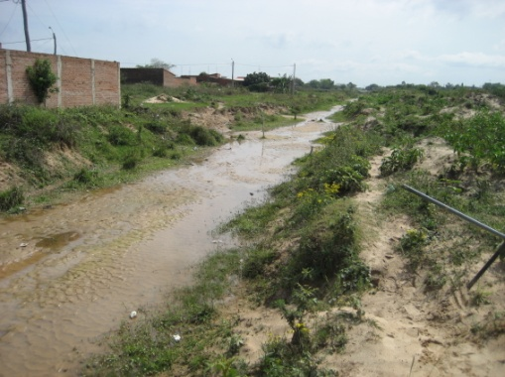
Canal Magisterio Currently

Slide 15
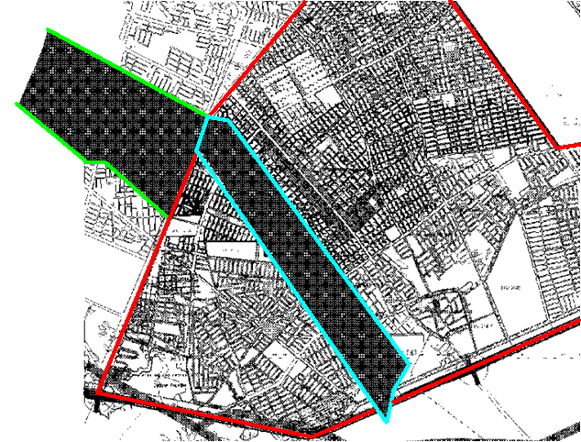
Where is the Water Coming From?

Slide 16
Canal Magisterio Existing Conditions
#1 project in District 12
Major drainage artery for District 9 & 12
Alleviate flooding in District 9 & 12
Improve quality of life

Slide 17
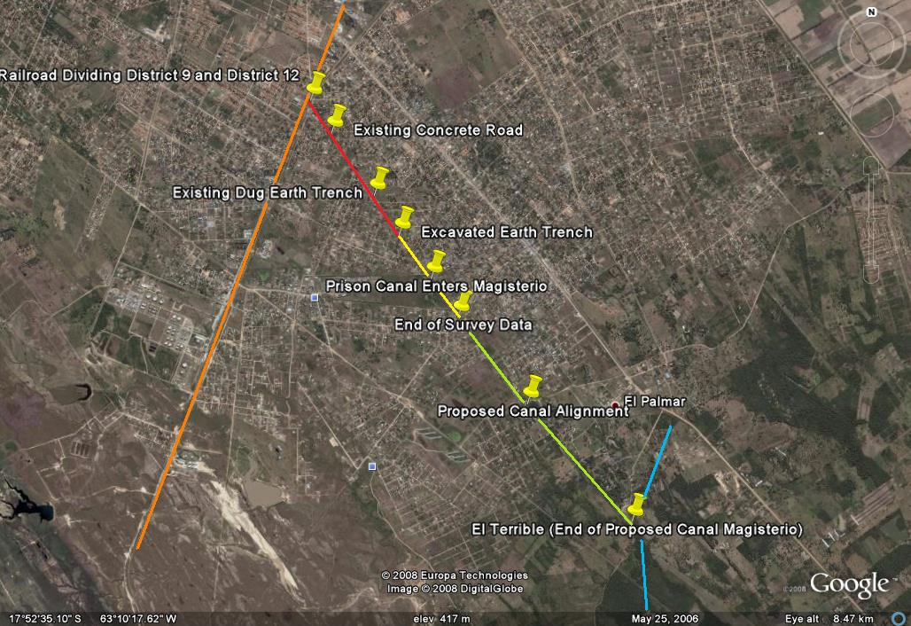
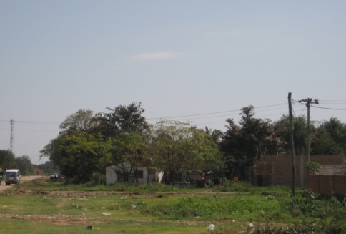
What Canal Magisterio will Accomplish
Suggest Design for Railroad Crossing
Concrete Lined Canal through Surveyed Section
Suggest study for El Terrible
Divided Two Lane Roadway
Earthen Canal Cross Section

Slide 18
Design Implemented Currently

Slide 19
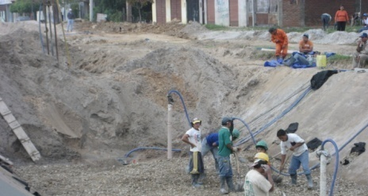
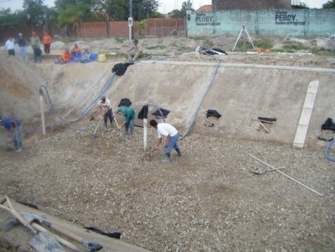
Canal construction process
Retaining Wall or Dam
Canal Excavated & Compacted
Geotextile Fabric & Rebar
Gravel Base Added

Slide 20
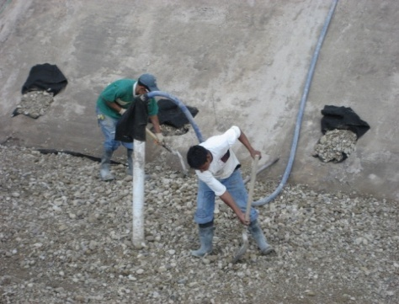
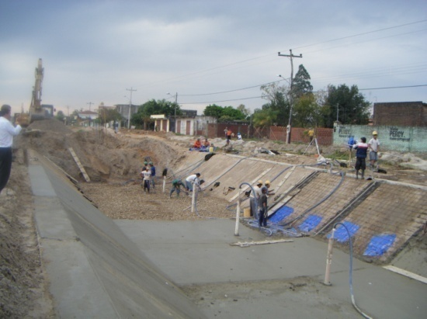
Side Drainage
Canal Floor Drains
Repeated for Entire Length of Canal
Notes:
Seep Holes relieve ground water Pressure

Slide 21
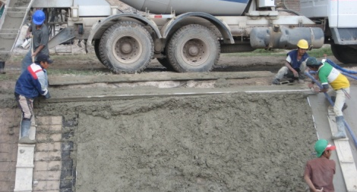
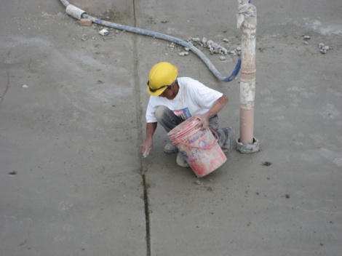
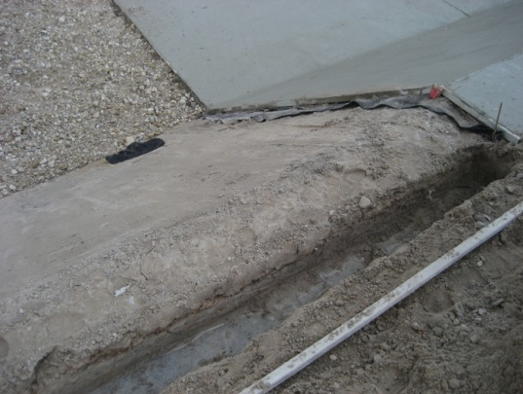
Placing Concrete
Joint Filling
Toe is Constructed at Top of Canal

Slide 22
Canal Designs Considered
Offer Economically Efficient Solution
Each Design will be Implemented in Specific Location
Concrete Box/Pipe
Earth
Canal
Concrete Lined
Ideal Trapezoid

Slide 23
Concrete Box/Pipe Culvert
Advantages
Space Efficiency
Safe
Difficult Maintenance
Debris
Clogging Inlets
High Cost
Disadvantages
Suggested for Railroad Crossing
Main Roadways Crossings

Slide 24
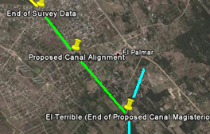
Earth Canal
Advantages
Shorter Construction Time
Low Cost
Disadvantages
Vegetation Overgrowth
High Maintenance
Erosion
Suggested for Un-Surveyed Portion to El Terrible Until Proper Alignment can be Determined

Slide 25
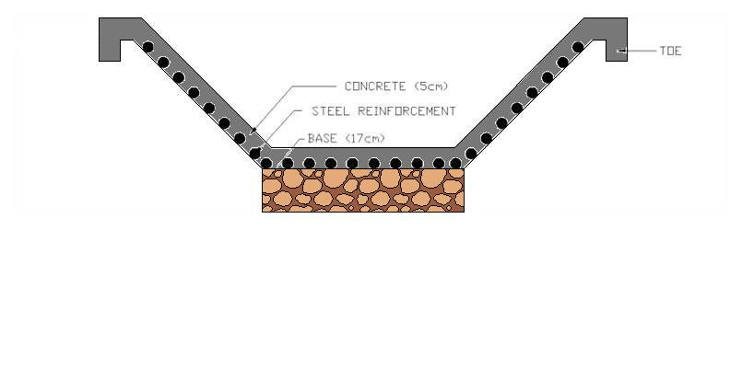
Concrete Lined Ideal Trapezoidal Canal
Advantages
Minimal Material Use
Optimal Flow
Capabilities
Disadvantages
Sanitation
Safety Issues
Constructability
Bolivian Canal Design
Ideal Trapezoidal Canal Design

Slide 26
Concrete Lined Ideal Trapezoidal Canal

Slide 27
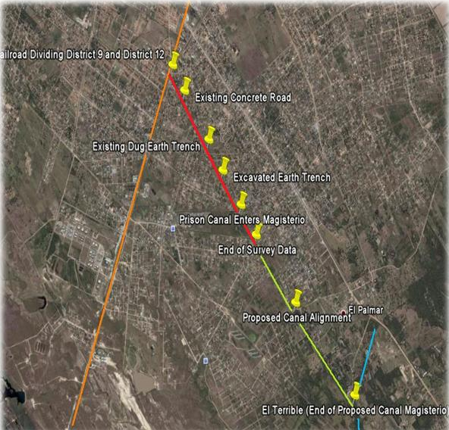
Proposed Canal Magisterio
Railroad
Concrete Canal
Earth Canal
El Terrible

Slide 28
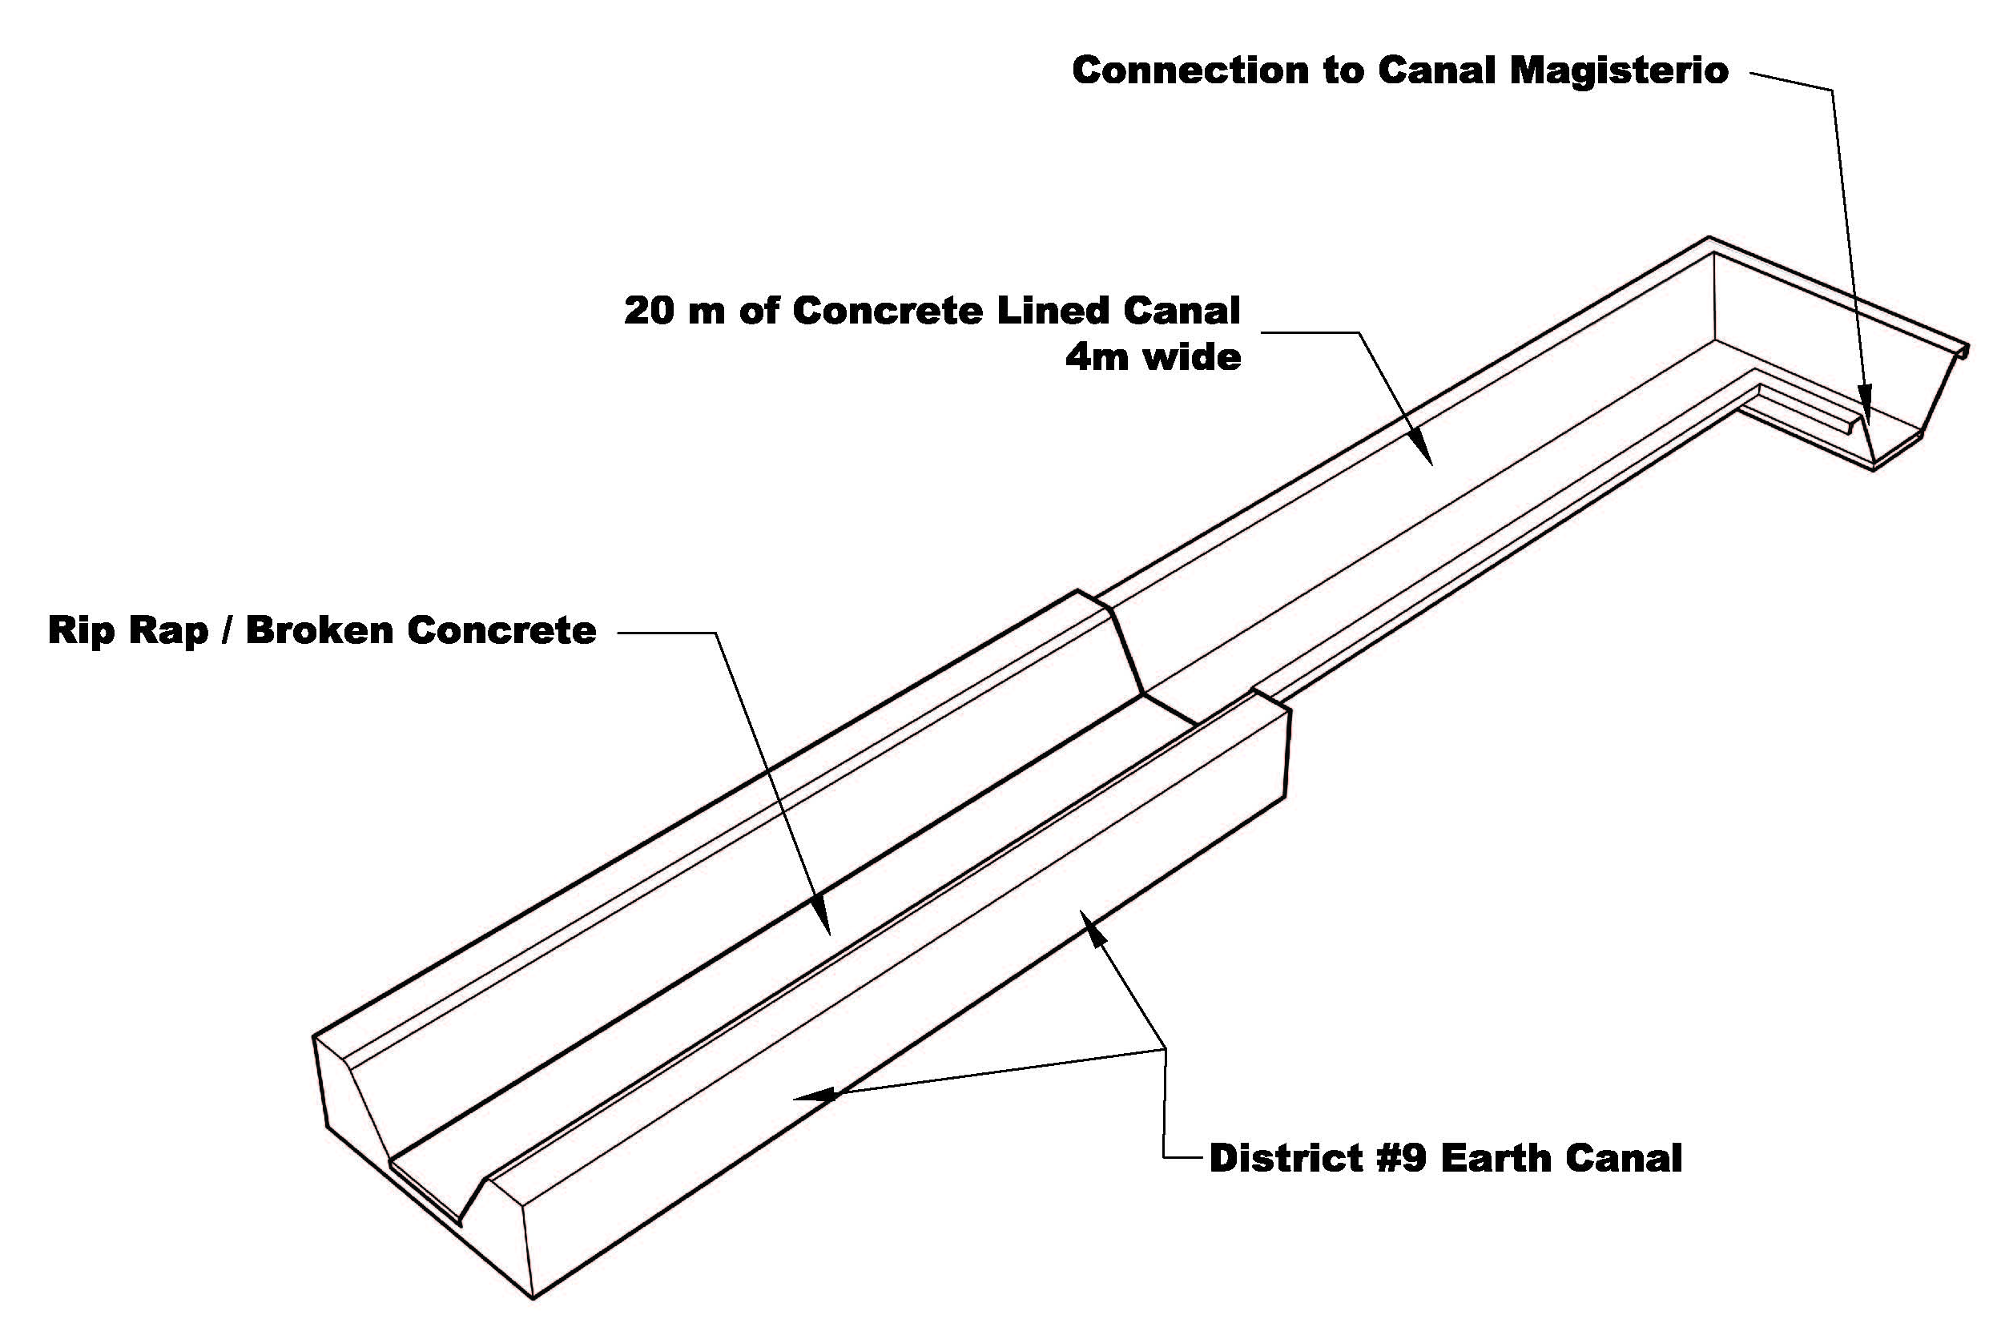
Final Canal Design
Water From District 9
20 m
20 m
20 m
20 m
Canal Magisterio

Slide 29
Design Alternative
Plan 4000

Slide 30
Divided Two Lane Roadway
Canal
Typical Bolivian Roadway
Curb
18 cm PCC
Portland Cement
Concrete (18cm)
Aggregate Base (12cm)
12 cm Agg Base

Slide 31
Pavement Options
Maximum Durability
Minimum Maintenance
Impermeable Material
Improve Road Quality
Environmental Concerns
Portland Cement Concrete Pavement
Least Expensive
Minimal Earthwork
Least Durable
Increased Maintenance
Compacted Earth
Road Grade Changes
Advantages
Disadvantages
Advantages
Disadvantages
TOO EXPENSIVE
Asphalt Concrete Pavement

Slide 32
Estimated Cost
Canal Total: $b 6.4 million
Road Total: $b 5.9 million
Project Total: $b 15.5 million
$US 2.2 million
175 work days to complete

Slide 33
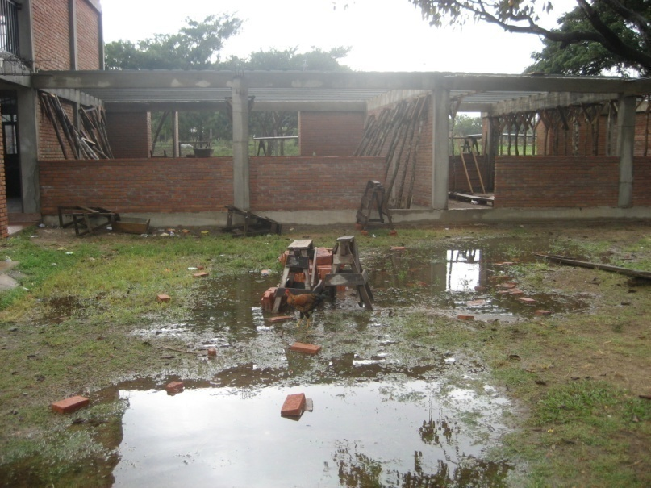
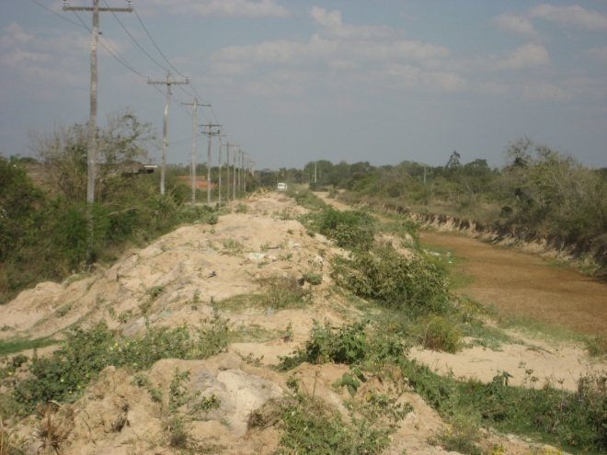
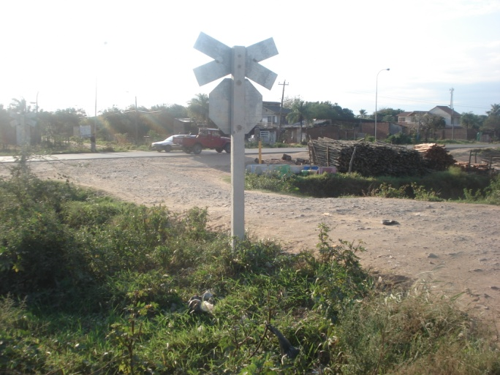
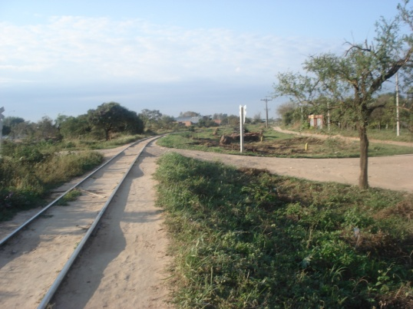
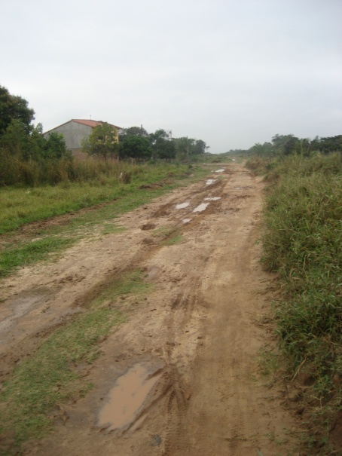
Impact on District 12

Slide 34
Personal Impact

Slide 37
Always Welcome

Slide 38
More than a Class…
Notes:
Hammocks???

